Slide 1


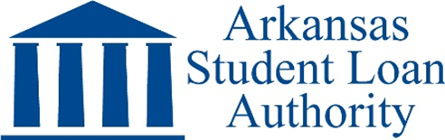

A Division of the Arkansas Development Finance Authority

Slide 2



Who is the Arkansas Student Loan Authority?
ASLA:
A state government agency established in 1977 by the Arkansas General Assembly
Became a Division of the Arkansas Development Finance Authority in 2017 (Department of Commerce)
Financially self-sustaining / No state revenue received
Issues revenue bonds for funding
ASLA Purposes:
To promote access to and information about higher education funding
To provide the most affordable student loan funding available to Arkansas families

Slide 3
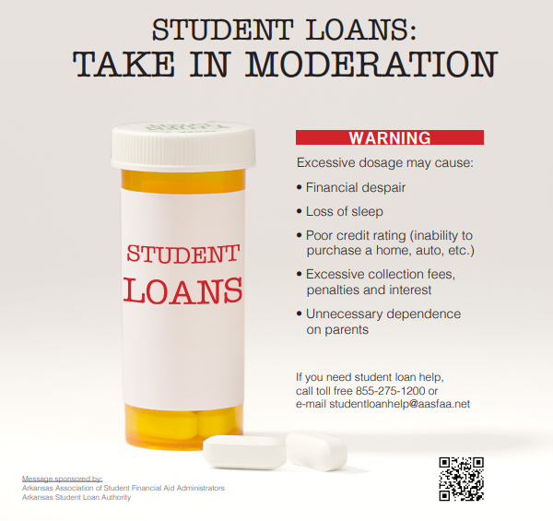

Slide 4
Arkansas Education Loans
Non-Federal Student Loans
Student Loans
Family/Parent Loans
Refinancing Loans
College Planning Services
Higher Ed Services
Free Online Scholarship Search
Financial Aid Workshops for High Schools
How To Pay For College Booklet
College Cost Calculator
Default Management Services
Student Engagement Campaigns
Financial Aid Support - Verification
College Contact Center

Slide 5


Slide 6
*All rates stated as Annual Percentage Rates with lender discounts included in the minimum rate.

Slide 7
ASLA
Default Management Partners
Arkansas State University
Arkansas State University – Beebe
Arkansas State University – Mtn. Home
Arkansas State University – Newport
Arkansas State University – Three Rivers
Arkansas Tech University
Black River Technical College
East Arkansas Community College
Henderson State University
National Park College
North Arkansas College
Southeast AR Community College
South AR Community College – El Dorado
Southern Arkansas University - Magnolia
Southern AR University Tech - Camden
U of A Community College – Batesville
U of A Community College at Hope
U of A at Monticello
U of A Pulaski Technical College
U of A at Rich Mtn. Community College
University of Central Arkansas

Slide 9
Cohort Default Rates – Arkansas vs. Nation
Default Rate Release Date | 2013 | 2014 | 2015 | 2016 | 2017 | 2018 | 2019 | 2020 | 2021 | 2022 | 2023
National Default Rate | 14.7% | 13.7% | 11.8% | 11.3% | 11.5% | 10.8% | 10.1% | 9.7% | 7.3% | 2.3% | 0.0%
Arkansas’s Default Rate | 19.0% | 15.8% | 14.5% | 14.0% | 12.2% | 11.2% | 10.4% | 10.8% | 7.0% | 2.1% | 0.0%
Arkansas’s National Ranking | 49th | 42nd | 43rd | 42nd | 31st | 30th | 27th | Not published by USDE | Not published by USDE | Not published by USDE | Not published by USDE

Slide 10

50,000 Booklets Printed Annually
Distributed to students through high school counselors
Spanish version available online

Slide 11

Student Loan Debt Statistics
Total Federal Student Loan Debt (June 30, 2023)
Arkansas: $13.4 Billion
Annual Federal Student Loan Volume Academic Year 2022-23
United States: $80,965,479,998
Arkansas: $607,136,674
Private Student Loans in Arkansas
Annual Volume (estimated): $60-$70,000,000
United States: $1.77 Trillion
Total Outstanding Balance (estimated): $1.1 Billion

Slide 13
Federal Student Loan Volume
Academic Year
2022-23
Notes:
Top 15?

Slide 14
Average FEDERAL Student Loan Debt
Per Borrower
Prior to 2023-24 Academic Year
United States: $37,718
State of Arkansas: $33,508
  399,000 Borrowers
  13% of AR Residents

Slide 15
Student Loan Options
Federal Direct Loans | Interest Rate | Origination Fee
Subsidized and Unsub | 5.50% | 1.06%
Graduate & Profess. Unsub | 7.05% | 1.06%
Parent PLUS & Grad PLUS | 8.05% | 4.23%
Arkansas Education Loans | Interest Rate | Origination Fee
Student Loans | 2.95% - 6.42% | 0%
Family/Parent Loans | 2.95% - 6.55% | 0%
National For-Profit Loans | Interest Rate | Origination Fee
Private Student Loans | 4.44% – 15.49% | 0%

Slide 16
Total Federal Student Loan Debt in AR by Age

Slide 17
Number of Arkansans with Federal Student Loan Debt by Age

Slide 18
Average Federal Student Loan Debt in AR by Age

Slide 19
Federal Direct Student Loan Volume by Loan Type
Loans Made Through Arkansas Higher Education Institutions – Award Year 2022-23

Slide 20
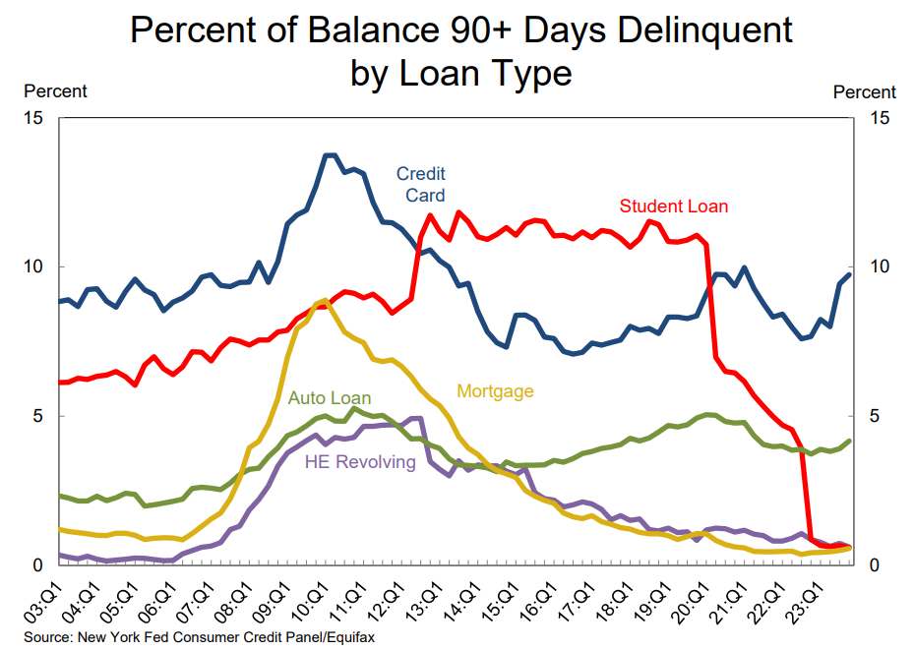

Slide 21
COVID Payment Pause: MAR 2020 - AUG 2023
Payment “On Ramp”: SEP 2023 – AUG 2024
Automatic Forbearance/Deferment if Delinquent
No Student Loan Defaults Until JUN 2026??
From COVID to Post-COVID
Return to Repayment

Slide 22
Student Loan Forgiveness under President Biden
June 2023 –
President’s plan to forgive $400 billion blocked by U.S. Supreme Court
March 21, 2024 – White House announcement
Biden-Harris Administration Approves Additional $5.8 Billion in Student Debt Relief for 78,000 Public Service Workers
Thru March 2024
  Total forgiven = $144 Billion / 4 million borrowers
    Administration changed rules on existing programs
    Many loans were in pipeline to be forgiven

Slide 23
Public Service Loan Forgiveness
November 2020 thru June 2023
Total For Arkansas: $400.8 Million
5,930 Borrowers
Average: $67,588
Eligibility Requirement: Must make the “equivalent of 120 qualifying payments”
Eligible employment includes:
Government agencies, not-for-profits, K-12 or higher education, healthcare, etc.

Slide 24
Biden-Harris Administration Approves $1.2 Billion in Loan Forgiveness for Over 150,000 SAVE Plan Borrowers
February 21, 2024
“…automatically discharge $1.2 billion in loans for nearly 153,000 borrowers who are eligible for the shortened time to forgiveness…”
“…7.5 million borrowers are now enrolled in SAVE,
4.3 million of whom have a $0 monthly payment.”
Early SAVE PLAN Forgiveness in AR: $8.7 Million
1,190 Borrowers

Slide 25
President Biden’s SAVE Repayment Program
Lowers monthly payments from 10% of discretionary income to 5%
  Graduate debt payments remains at 10% of discretionary income
Forgiveness provisions:
  Implements forgiveness after 10 years for borrowers with original balance of $12,000 or less
  Original loans between $12,000 and $22,000 eligible for forgiveness on sliding scale from 11 to 19 years
  Retains forgiveness after 20 years for borrowers with original balances above $22,000
Highlights -
Single borrowers making $30,600 or less will pay $0 monthly
Married couples with 2 kids making $62,400 will pay $0 monthly
Making $0 monthly payments count towards loan forgiveness
Unpaid interest is forgiven each month

Slide 26
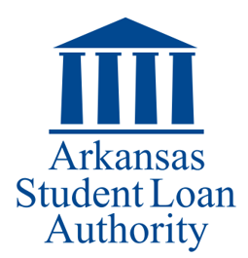
The Arkansas Student Loan Authority can help…
Families/Students with:
FAFSA completion
Financial aid decisions, especially related to student loans
Student loan management beyond college
Refinancing student loans
Higher Education Institutions with:
Default Management
Student Engagement Campaigns
High School Counselors with:
College Planning Webinars
How To Pay For College Booklets
FAFSA Completion

Slide 27



